Slide 1

SQL CASE STUDY TINY SHOP SALES
Hashmeet Kaur

Slide 2
CONTENTS
Introduction
Datasets
ER Diagram
Finding Insights
Conclusion

Slide 3
INTRODUCTION
This challenge is introduced by Data In Motion, to analyze and derive insights of Tiny Shop Sales data, with the help of SQL Queries and get exposed to following areas :
Basic Aggregations
CASE WHEN Statements
Window Functions
Joins
Date Time Functions
CTEs
The dataset link : SQL Case Study 1: Tiny Shop Sales – Data in Motion (d-i-motion.com)

Slide 4
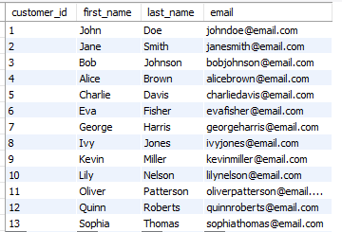
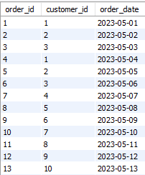
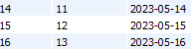
DATASETS
CUSTOMERS TABLE
ORDERS TABLE

Slide 5
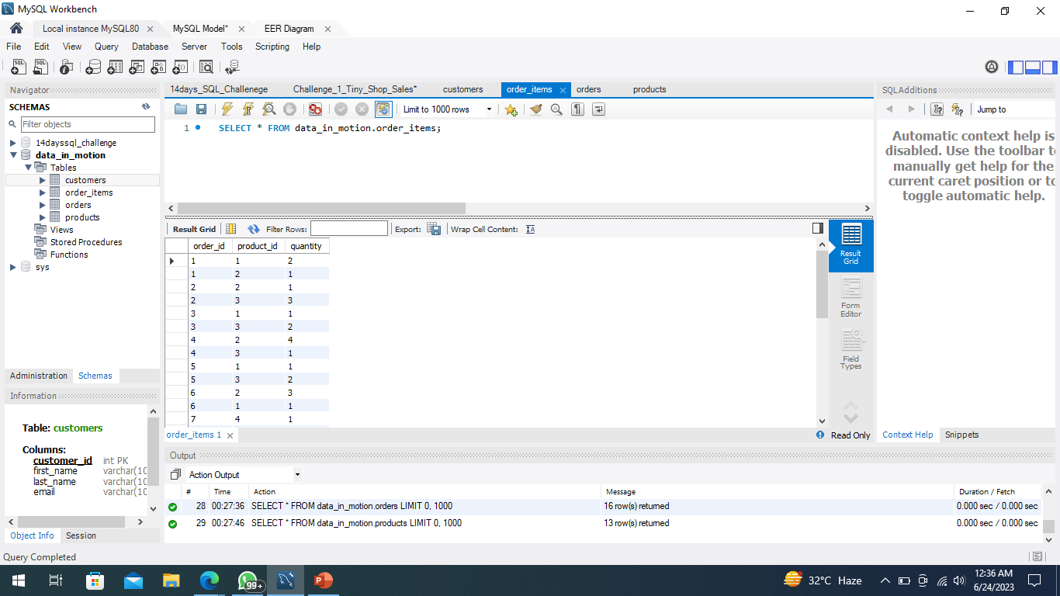

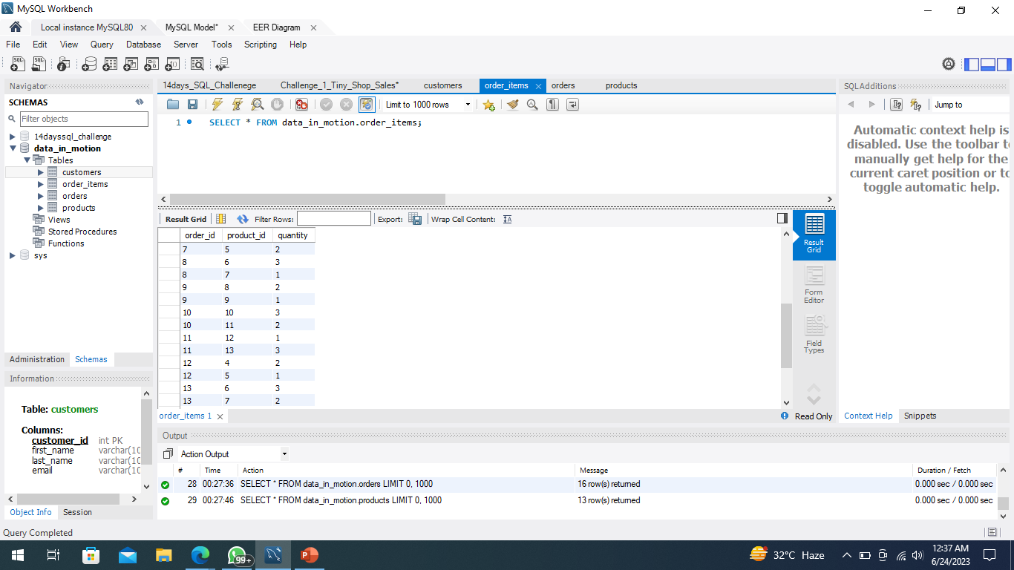

ORDER ITEMS TABLE
PRODUCTS TABLE

Slide 6
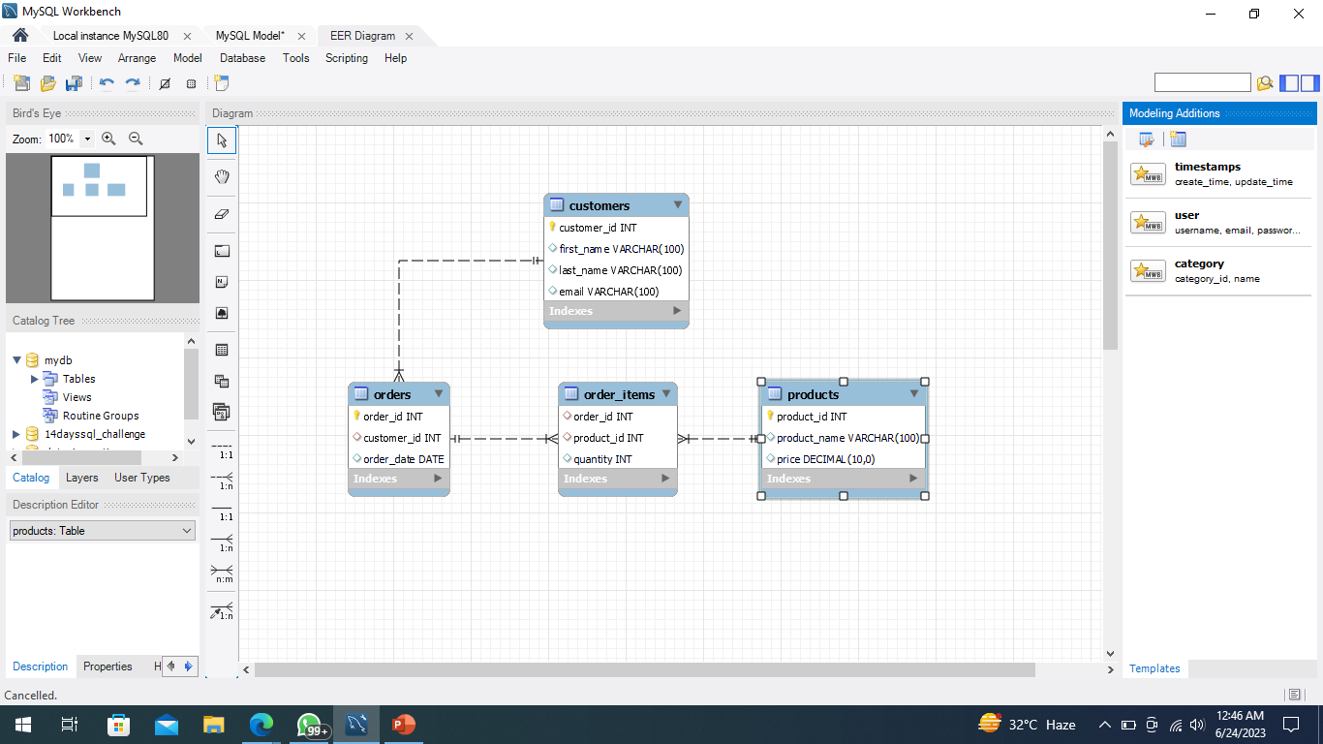
ER DIAGRAM

Slide 7
FINDING INSIGHTS
Which product has the highest price? Only return a single row.
Which customer has made the most orders?
What’s the total revenue per product?
Find the day with the highest revenue.
Find the first order (by date) for each customer.
Find the top 3 customers who have ordered the most distinct products
Find the top 3 customers who have ordered the most distinct products
What is the median order total?
For each order, determine if it was ‘Expensive’ (total over 300), ‘Affordable’ (total over 100), or ‘Cheap’.
Find customers who have ordered the product with the highest price.

Slide 8
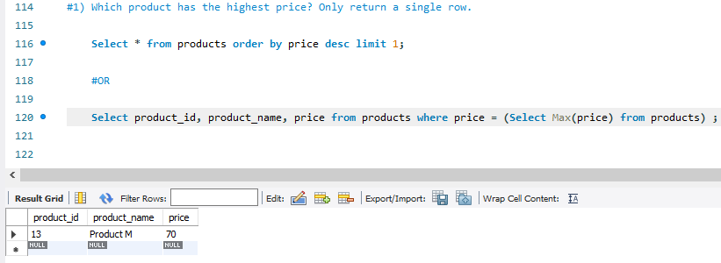
1) Which product has the highest price? Only return a single row.

Slide 9
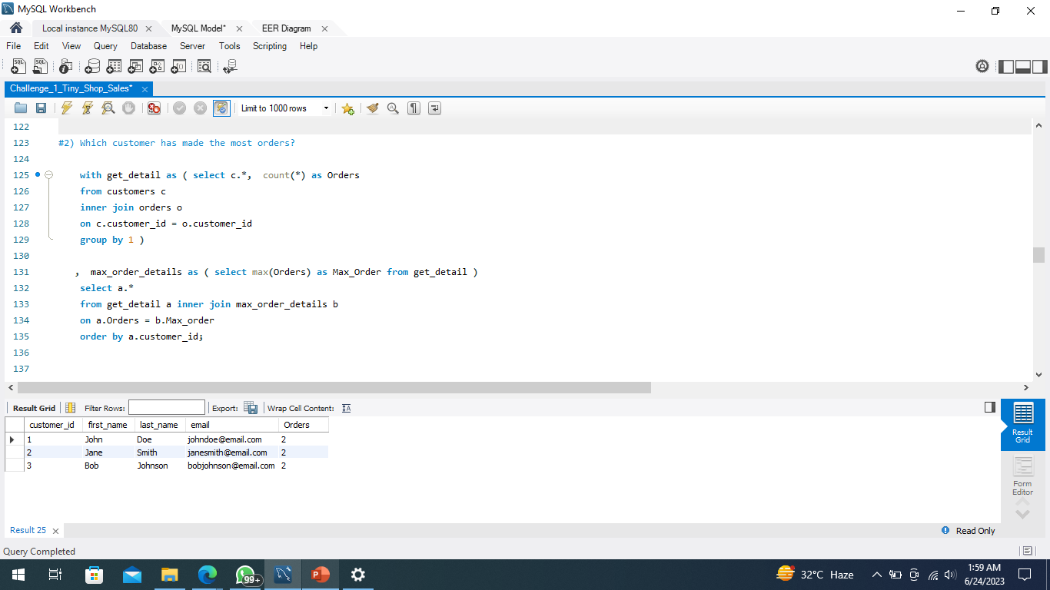
2)Which customer has made the most orders?

Slide 10
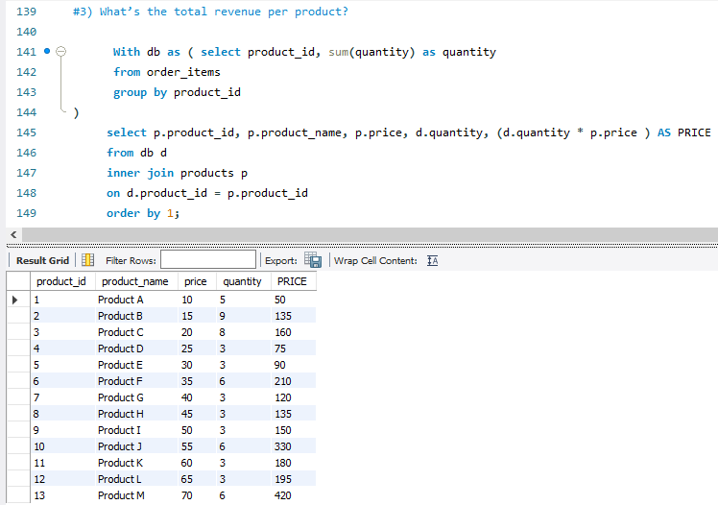
3) What’s the total revenue per product?

Slide 11
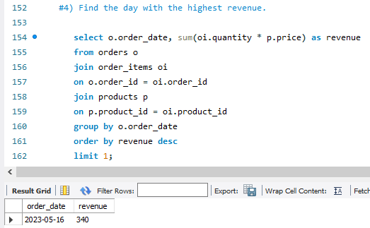
4) Find the day with the highest revenue.

Slide 12
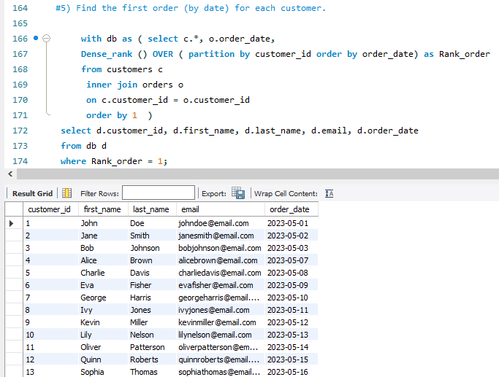
5) Find the first order (by date) for each customer.

Slide 13
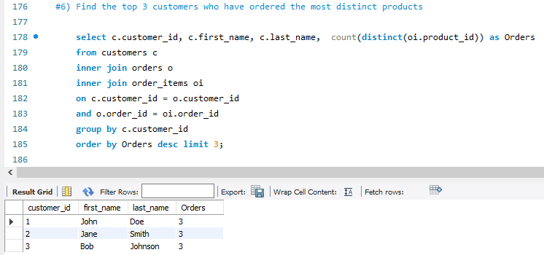
6) Find the top 3 customers who have ordered the most distinct products

Slide 14
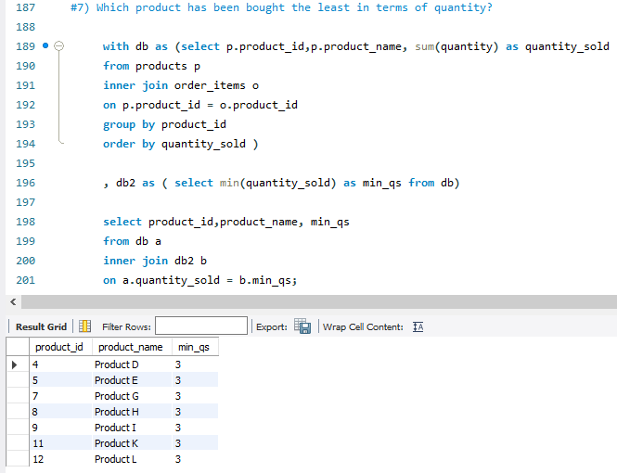
7) Which product has been the least in terms of quantity?

Slide 15
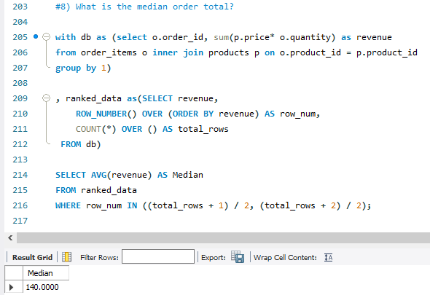
8) What is the median order total?

Slide 16
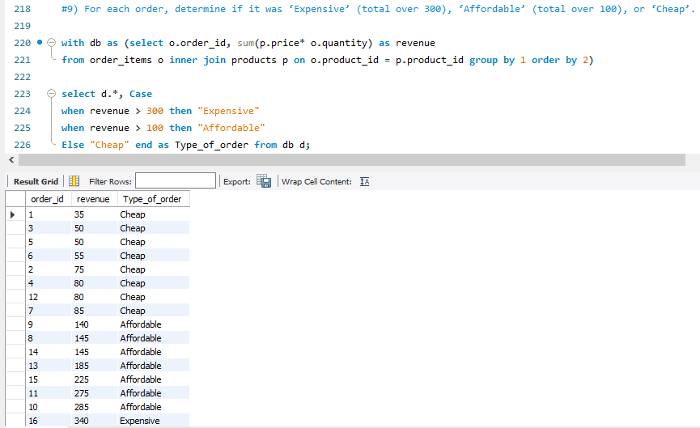
9) For each order, determine if it was ‘Expensive’ (total over 300), ‘Affordable’ (total over 100), or ‘Cheap’.

Slide 17
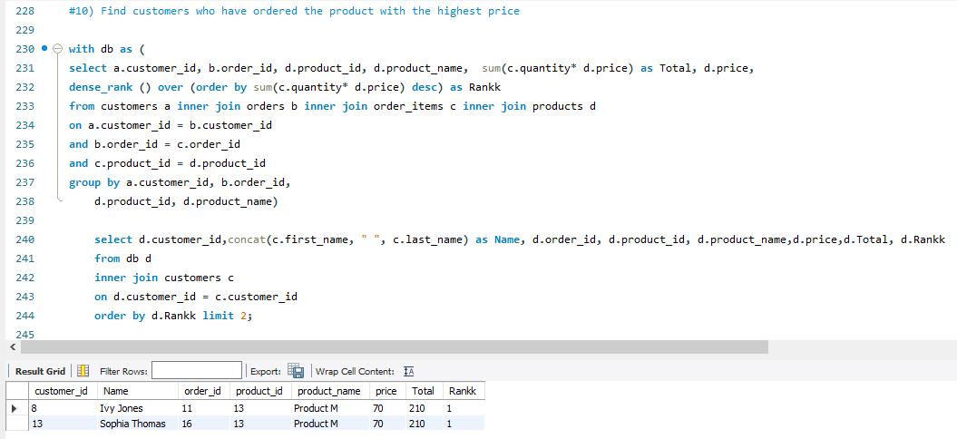
10) Find customers who have ordered the product with the highest price.

Slide 18
SUMMARY
Product M shows the highest price item.
John Doe, Jane Smith, and Bob Jhonson are the customers who have made the maximum orders overall, and distinct orders.
Highest Revenue made in the shop was on 16 May 2023.
The median order total with overall sales is $140 that help us to find out the transactions made by the shop.
Ivy Jones, and Sophia Thomas are the customers who have ordered products with highest price.

Slide 19
THANK YOU
Hashmeet Kaur​
hashmeetk.hk@gmail.com
Hashmeet (HK) Kaur | LinkedIn
hashmeet22 (HASHMEET KAUR) (github.com)

